Slide 1
Numerical Issues in GPU Programs
Ravishka Rathnasuriya

Slide 2
GPU Numeric Issues
NVIDIA GPUs can run operations in float16 faster than in float32. Variables and a few computations should still be in float32 for numeric reasons so that the model trains to the same quality. Float16 for matrix multiplications and convolutions. Keras mixed precision API allows you to use a mix of either float16 or bfloat16 with float32, to get the performance benefits from float16/bfloat16 and the numeric stability benefits from float32. https://github.com/tensorflow/tensorflow/issues/41783
Mixed Precision computation: float32- variables float16- computations Overflow, underflow issues, type casting issues
Older GPUs offer no math performance benefit for using mixed precision. Examples of GPUs that will benefit most from mixed precision include RTX GPUs, the V100, and the A100. FP32 always uses CUDA cores. FP16 may or may not use tensor cores. https://github.com/opencv/opencv/issues/17969 https://www.tensorflow.org/guide/mixed_precision#overview
Integer quantization is mainly for CPU since CPU calculates integer better than float number. When you run it on GPU, it converts integer to float internally. https://github.com/tensorflow/tensorflow/issues/40357 https://www.tensorflow.org/lite/performance/post_training_quantization
Arithmetic (add, sub, mul, div) is not implemented for float16 on CPU. (Not just in-place ops). These ops are implemented for GPU. https://github.com/dotnet/TorchSharp/issues/160

Slide 3
Inconsistent handling of NaNs on Cuda vs CPU tensors https://github.com/torch/cutorch/issues/289
IEEE half-precision 16-bit float (5 bits exponent, 10 bits fraction) bfloat16 (8 bits exponent, 7 bits fraction) https://github.com/WebAssembly/wasi-nn/issues/3
The NVIDIA GPU architecture uses a little-endian representation. numPy supports little- and big-endianness. CuPy arrays only use little-endian arrays. Big-endian arrays lead to wrong results
Low double precision performance of the GPU used
CuPy does not support dtype=object arrays. NumPy does https://github.com/cupy/cupy/issues/3701

Slide 4
Methodology
Keyword search on existing open-source GitHub projects that use GPU programs
From Exiting CPU numerical bugs study: nan, overflow, underflow, infinity, infinite, precision, unstable, instability, ringing, unbounded, roundoff, truncation, rounding, diverge, cancellation, cancel, accuracy, accurate
Added: numeric, floating, floats, fp, cufft, cublas, curand, cuda math library, cusolver, cusparse, cutensor, GPU, GPU Programming

Slide 5
CuPy numerical library
-Added numerical issues related to CuPy library in addition to the issues with keyword search.
-CuPy is a NumPy/SciPy-compatible array library for GPU-accelerated computing with Python.
-CuPy acts as a drop-in replacement to run existing NumPy/SciPy code on NVIDIA CUDA or AMD ROCm platforms.
-Provides access to low-level CUDA features.
-Can pass ndaaray to existing CUDA C/C++ programs via RawKernels, use Streams for performance, or even call CUDA Runtime APIs directly.
-Also supports CUDA math libraries such as:
cuBLAS - GPU-accelerated basic linear algebra (BLAS) library cuFFT - GPU-accelerated library for Fast Fourier Transforms CUDA Math Library- GPU-accelerated standard mathematical function library cuRAND - GPU-accelerated random number generation cuSOLVER - GPU-accelerated dense and sparse direct solvers cuSPARSE- GPU-accelerated BLAS for sparse matrices cuTENSOR - GPU-accelerated tensor linear algebra library
More about CuPy:
https://cupy.dev/

Slide 6
Summary of Issues
 | No. of issues in the dataset | Total inspected issues
Keyword search | 165 | 560
CuPy | 37 | 85
Total | 202 | 645

Slide 7
Root Cause
 | Accuracy Bugs | Correctness Bugs | Special Value Bugs | Environmental Issue
Keyword Search | 44 | 84 | 26 | 11
CuPy | 6 | 26 | 4 | 1
Total | 50 | 110 | 30 | 12

Slide 8
Symptoms
 | Crash | Performance Issue | Wrong Results
Keyword search | 85 | 23 | 57
CuPy | 17 | 5 | 15
Total | 102 | 28 | 72

Slide 9
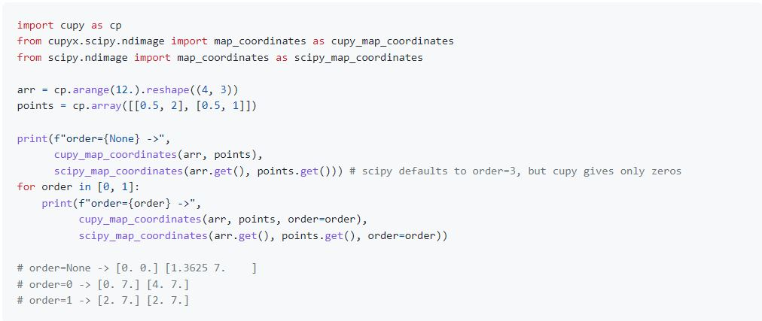


Accuracy Bugs -Numerical Precision Issue -Overflow/Underflow issues -Roundoff/ Truncates -Datatype Casting Issue
https://github.com/cupy/cupy/issues/4550

Slide 10
Accuracy bugs produced symptoms - Wrong results due to incorrect numerical precisions/rounding offs/truncations. Compared with CPU results -Error messages related to overflow/underflow/casting issues -Slow performance or high memory use
Common fixing strategies -By using high precision numbers -Fixing values in functions used to computations (arithmetic expressions) -Using cast strategies like upcasting
Unit testing can be implemented to test for different data types for arithmetic expressions to fix overflow/underflow issues/casting issues.

Slide 11
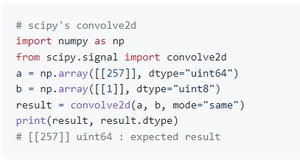
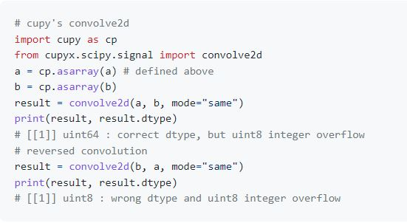
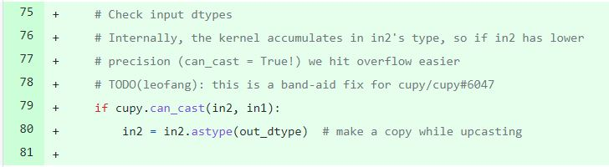
https://github.com/cupy/cupy/issues/6047

Slide 12
Correctness Bugs -Errors in using incorrect datatypes in expressions -Errors in unsupported datatypes in compiler optimizations -Divide by zero issue
Correctness Bugs show symptoms -Compile Errors, Type Errors, infinite loop -Slow performance due to incorrect expression -floating point exceptions due to divide by zero issue
Fixing Strategies -Need domain specific knowledge to know the data types that supports -Updating the versions fix the issues for datatypes (Updating TF version or moving to TF-nightly version) -Fixing expressions/using correct expressions. -Avoid using type conversions in certain optimization levels
CuPy uses RawKernel, ReductionKernel, Element-wise Kernel that is not supported for numPy, sciPy RawKernel- cupy.RawKernel: Easily uses raw CUDA C kernel functions from python
ReductionKernel – cupy.ReductionKernel : Defines the own custom reduction kernel operation
Element-wise Kernel- cupy.ElementwiseKernel :Defines custom element wise operation kernel

Slide 13
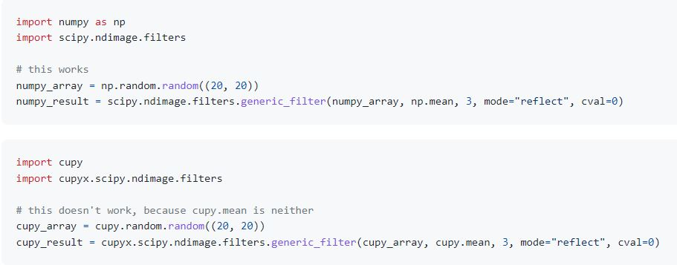

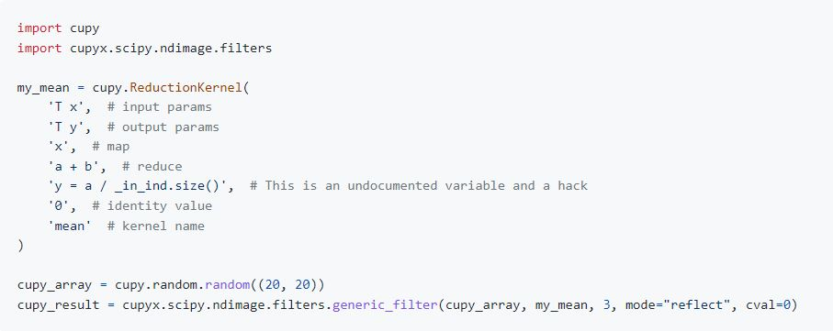
can't pass cupy functions (cupy.mean)
https://github.com/cupy/cupy/issues/3909

Slide 14
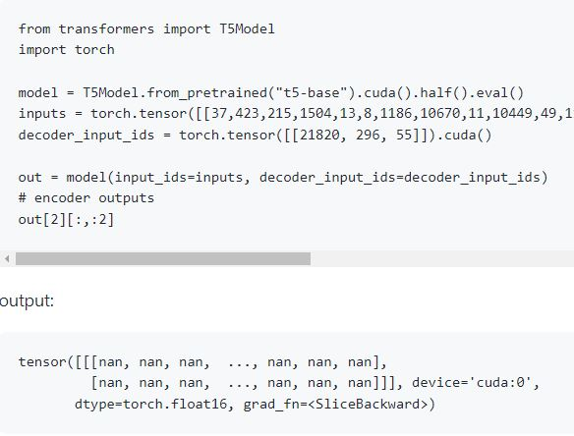


Special Value Bugs NaN issues inf issues -0/0 issue
Special Value bugs produce symptoms -Incorrect results (producing NaN results)
Fixing Strategies -Adding NaN checks (Need understanding on when to check NaNs) -Checks for -0 - Avoid using values lower than the smallest FP16 value
https://github.com/huggingface/transformers/issues/4586
Layer_output contains inf values

Slide 15
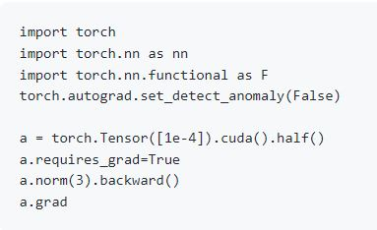
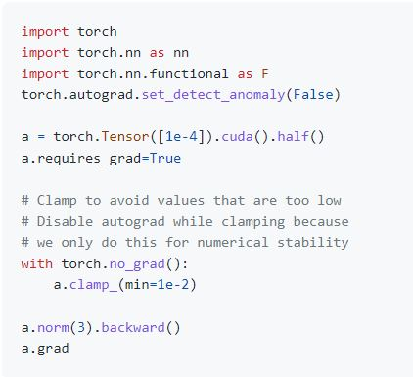
https://github.com/pytorch/pytorch/issues/43211

Slide 16
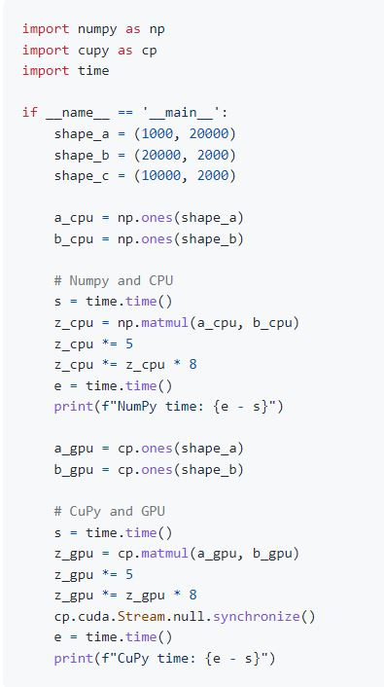
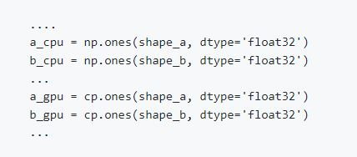
Environmental Issues -GPU specific issues (Some GPUs work well with mixed precisions) -FP64 Support in GPUs
Symptoms -performance Issue
Fixes Lower the FP64 to FP32 Change GPUs
https://github.com/cupy/cupy/issues/4891

Slide 17
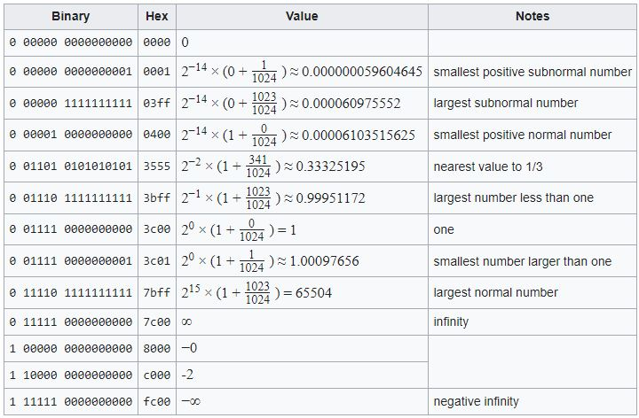
Future Work
Add more issues related to CuPy libraries because CuPy addresses many numerical issues related to GPUs where numPy and sciPy libraries work well in CPUs.
Tools can be built for unit testing for different datatypes. Datatypes: Mixed Precision, FP16,FP32,FP64,Bfloat16, TF32, Complex32, Complex128…. Most of the issues related to CuPy needs developers understanding to fix the issue.

